Slide 1
ROCK PAPER SCISSOR GAME
BY-
SUBHANSHI RAWAT (2K19/IT/126)
MIR OMID MIRZADA (2K19/IT/152)
SUBMITTED TO-
Ms. SWATI SHARDA
FACULTY SUPERVISOR

Slide 2
I hereby declare that project report entitled “ROCK PAPER SCISSOR GAME IMPLEMENTED USING JAVASCRIPT / HTML / CSS “ submitted by (Mir Omid Mirzada 2K19/IT/152) and (Subhanshi Rawat 2K19/IT/126) to Delhi Technological University (DTU), Delhi is a record of original work done under the guidance of Prof. Swarti Sharda for the course of DISCRETE STRUCTURES. All the codes and implementations are completely written by me and my partner.
DECLARATION
BY-
SUBHANSHI RAWAT (2K19/IT/126)
MIR OMID MIRZADA (2K19/IT/152)
SUBMITTED TO-
Ms. SWATI SHARDA
FACULTY SUPERVISOR

Slide 3
This is to certify that Mir Omid Mirzada Roll No 2K19/IT/152 and Subhanshi Rawat Roll No 2K19/IT/126 of IT-2 batch Information technology department (IT) hasve successfully completed the project work entitled “ROCK PAPER SCISSOR GAME IMPLEMENTED USING JAVASCRIPT / HTML / CSS ” on DISCRETE STRUCTURES for Third Semester which is to be evaluated as the Mid Term Component.
Signature:
Date :30-11-2020
CERTIFICATE

Slide 4
I would like to express my special thanks of gratitude to my teacher Prof. Swarti Sharda as well as our college(Delhi Technological University, Delhi )which gave me the golden opportunity to do this wonderful project on the topic “Discrete structures IMPLEMENTED USING JAVASCRIPT / HTML / CSS ” , which also helped me in doing a lot of Research and I came to know about so many new things I am really thankful to them.
Secondly i would also like to thank my parents my classmates and friends who helped me a lot in finalizing this project within the limited time frame.
ACKNOWLEDGEMENT

Slide 5
Rock, Paper, Scissors is a simple hand game with many names and variations. It is played around the world and is commonly used as a way of coming to decisions. In some cases is even played for sport. The rules require that competing players use one hand to form one of three shapes at an agreed-upon time. The person that plays the strongest “object” is the winner of the game. It's that easy! Rock, Paper, Scissors is a simple game that anybody can play and win. There is no intrinsic advantage to the stronger, older, or more experienced opponent.
ABSTRACT

Slide 6
Chapter 1.2: Brief Intro of all the API’s and components used
1
2
3
HTML5
CSS3
JavaScript
Hypertext Markup Language is the standard markup language for documents designed to be displayed in a web browser. It can be assisted by technologies such as Cascading Style Sheets and scripting languages such as JavaScript
Cascading Style Sheets is a style sheet language used for describing the presentation of a document written in a markup language such as HTML. CSS is a cornerstone technology of the World Wide Web, alongside HTML and JavaScript
JavaScript, often abbreviated as JS, is a programming language that conforms to the ECMAScript specification. JavaScript is high-level, often just-in-time compiled, and multi-paradigm. It has curly-bracket syntax, dynamic typing, prototype-based object-orientation, and first-class functions

Slide 7
The rules are very simple and probably you remember them from your childhood:
•If you choose Rock, you will win against Scissors but lose against Paper.
•If you choose Scissors, you will win against Paper but lose against Rock.
•If you choose Paper, you will win against Rock but lose against Scissors.
There can be 3 to 5 rounds. The game ends when somebody gets 3 wins. If you want to play again, just click “Play again” button after a game is finished.
What are the rules?

Slide 8
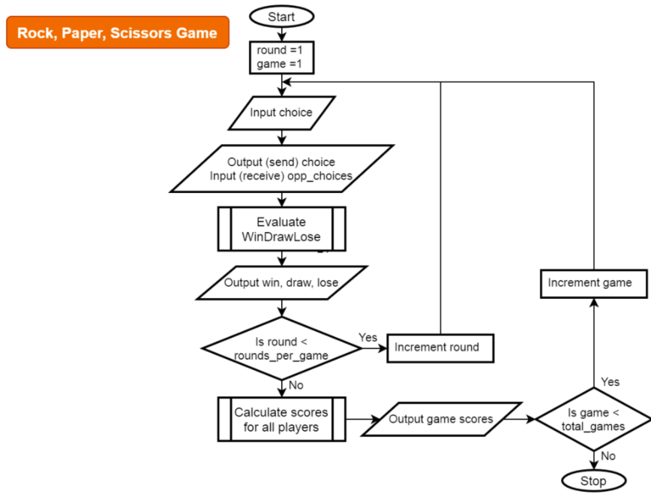

Slide 9
The familiar game of Rock, Paper, Scissors is played like this: at the same time, two players display one of three symbols: a rock, paper, or scissors. A rock beats scissors, scissors beat paper by cutting it, and paper beats rock by covering it. In this simulation, the computer has two different strategies that it can follow.
Rock, paper, scissors is an example of a zero-sum game without perfect information. Whenever one player wins, the other loses. We can express this game using a payoff matrix that explains what one player gains with each strategy the players use. In the payoff matrix below, the rows represent player 1's possible strategies while the columns represent player 2's possible strategies. 1 represents a win for player 1, 0 a tie, and -1/2 for a loss for player 1. So, for instance, the upper left entry is a 0 because if both players display rocks, they tie. The upper middle entry is a -1/2 because if player 1 displays a rock and player 2 displays paper, player 2 wins, and therefore, player 1 loses.
ROCK PAPER SCISSOR

Slide 10
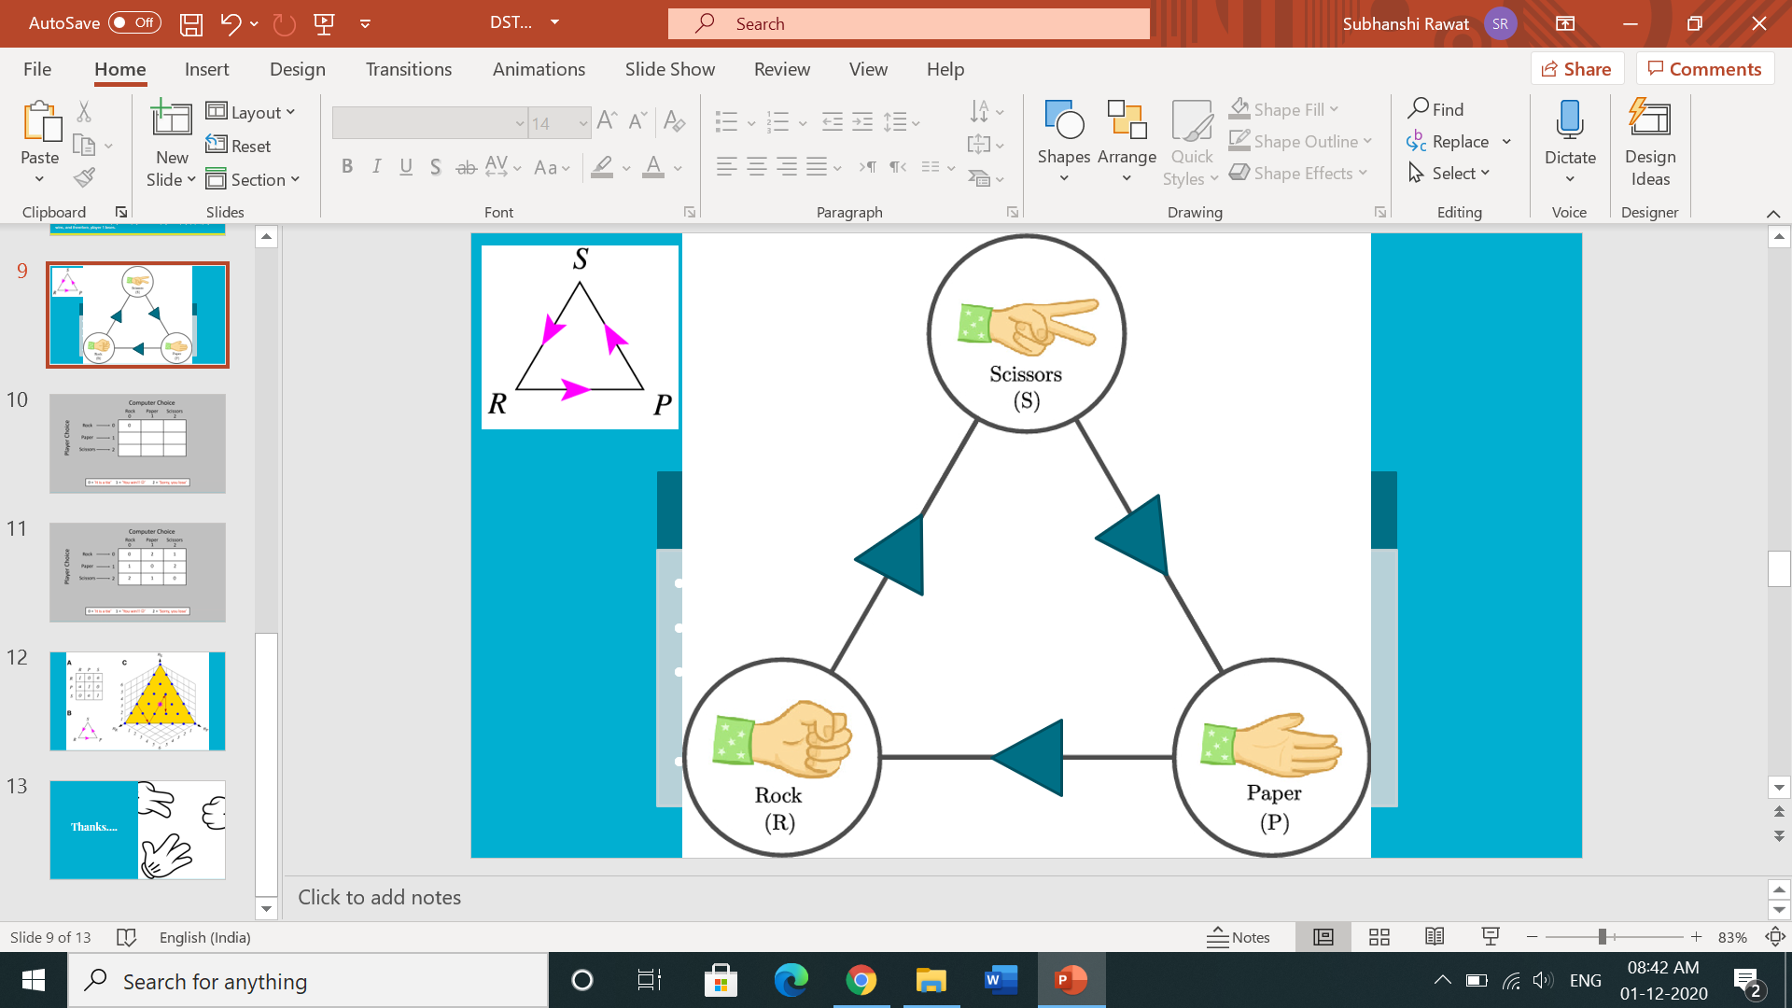
WIN
R S
S P
TIE
R R
P P
LOOSE
S R
P S
P R
3 cases
S S
3 cases
R P
3 cases
P(W)= 3/9
P(T)= 3/9
P(L)= 3/9

Slide 11
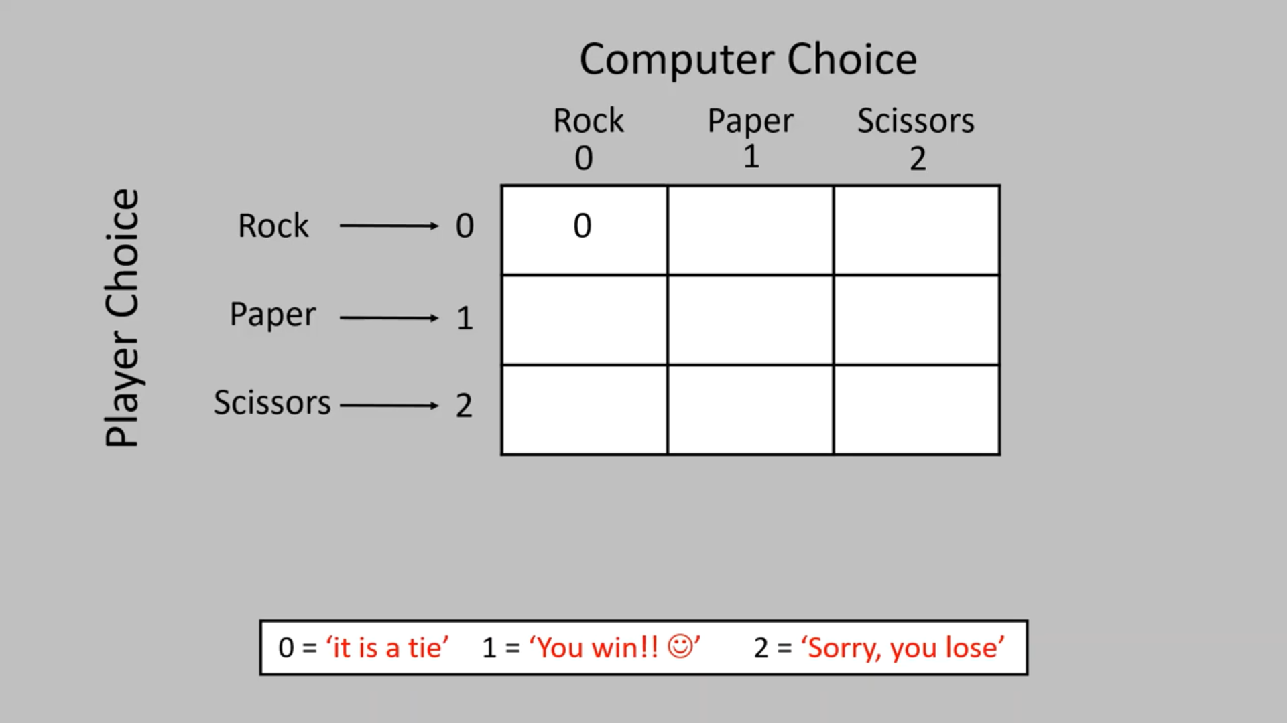

Slide 12


Slide 13
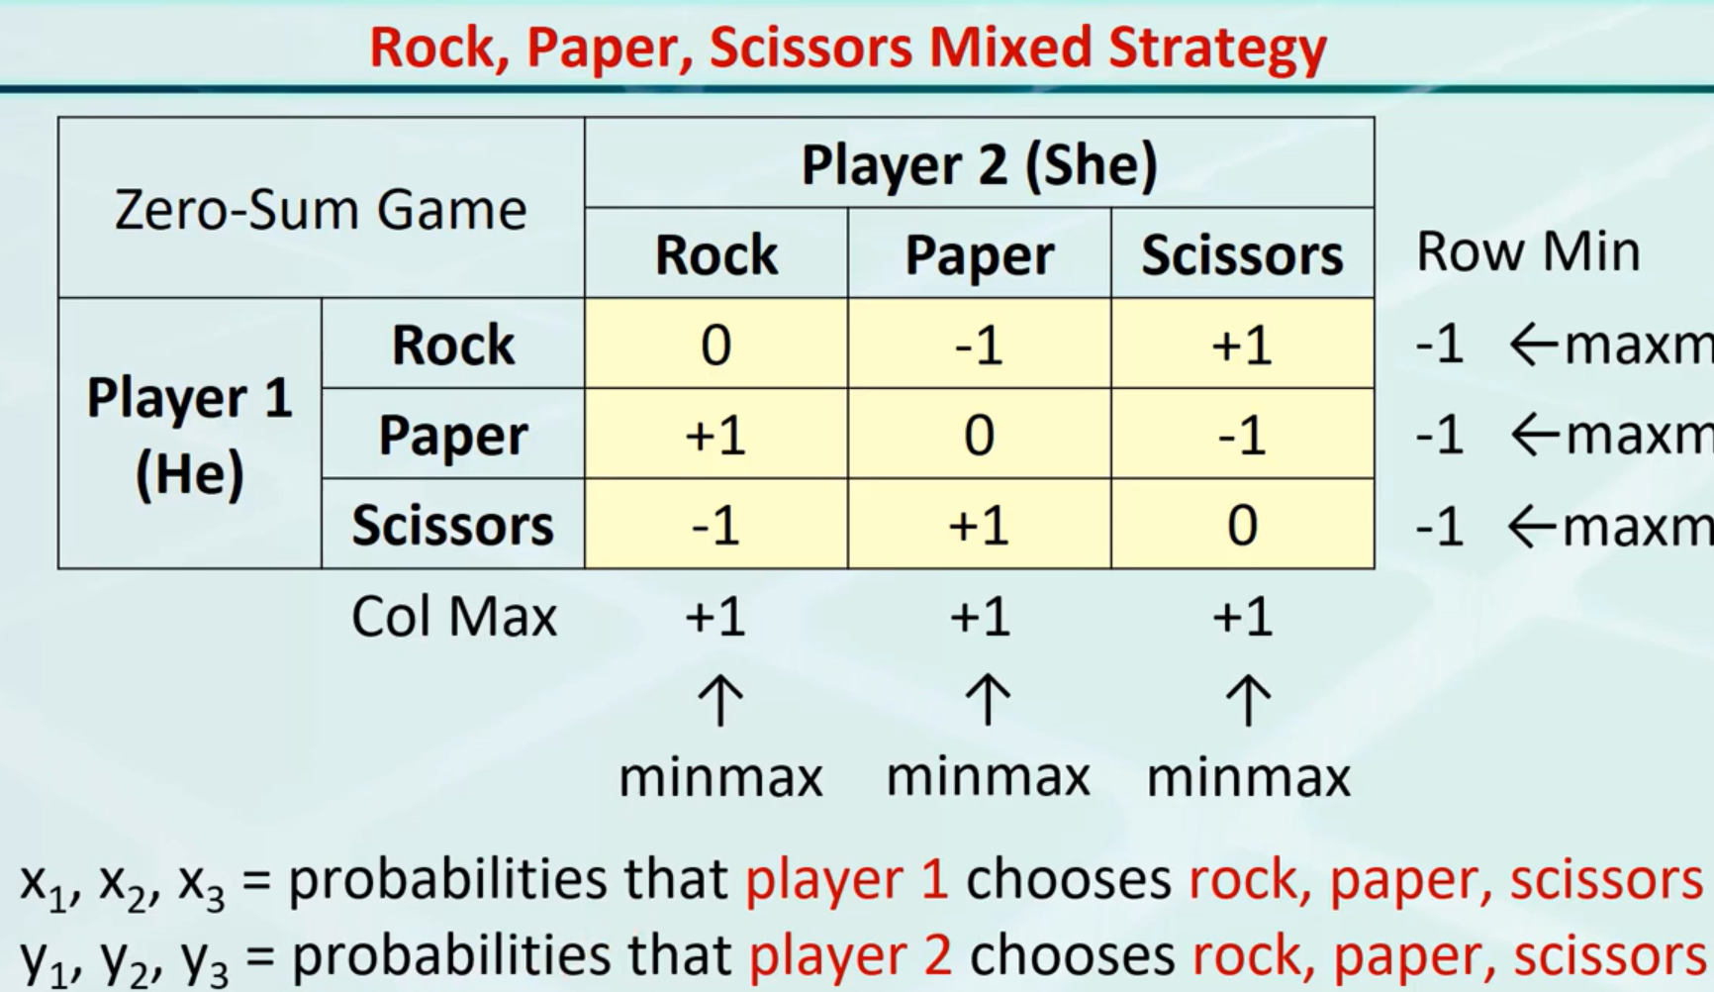
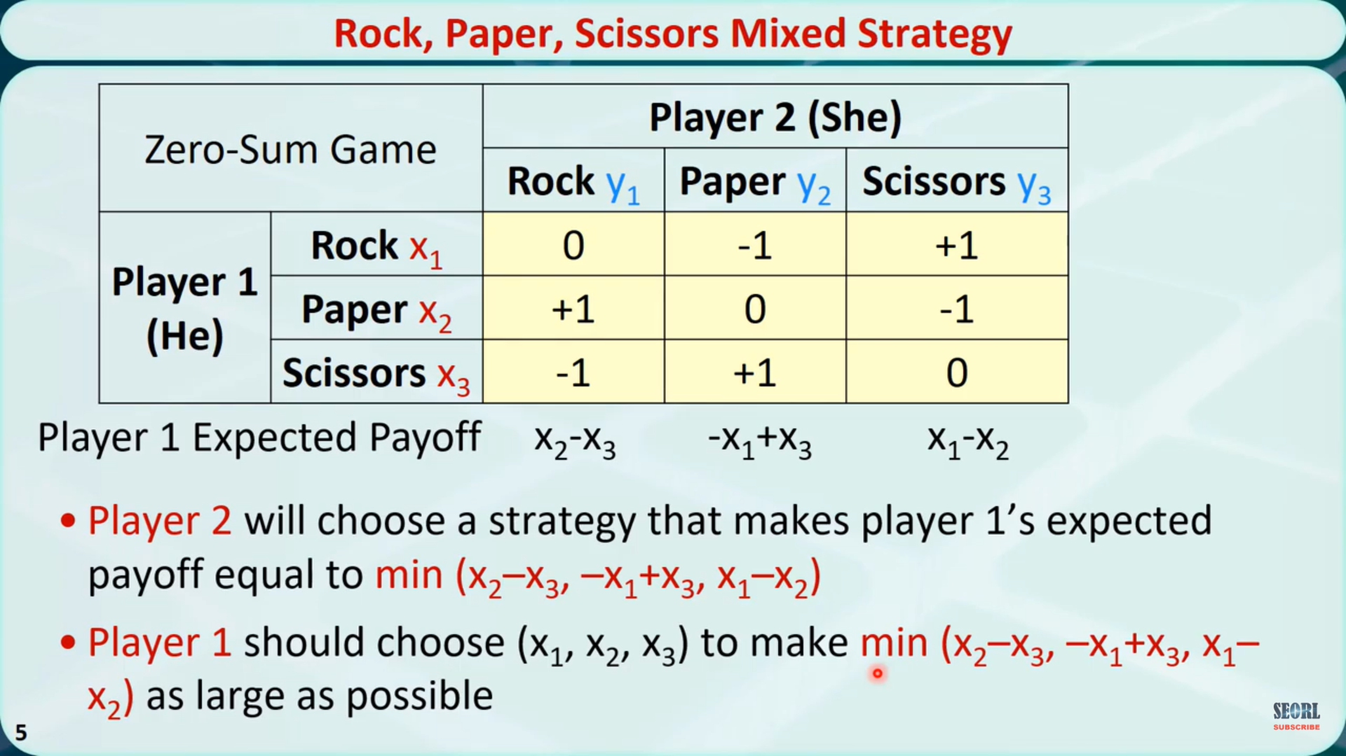

Slide 15
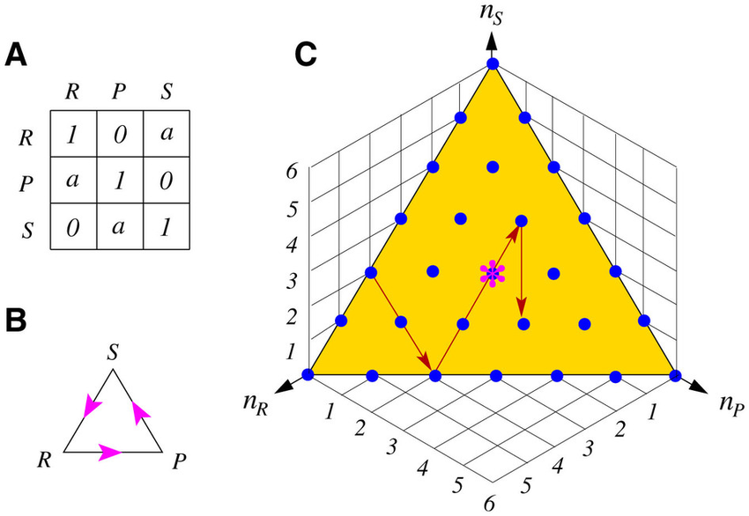

Slide 16
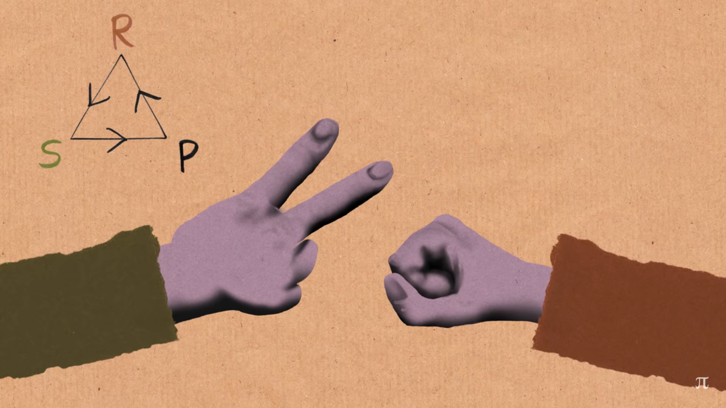

Slide 17
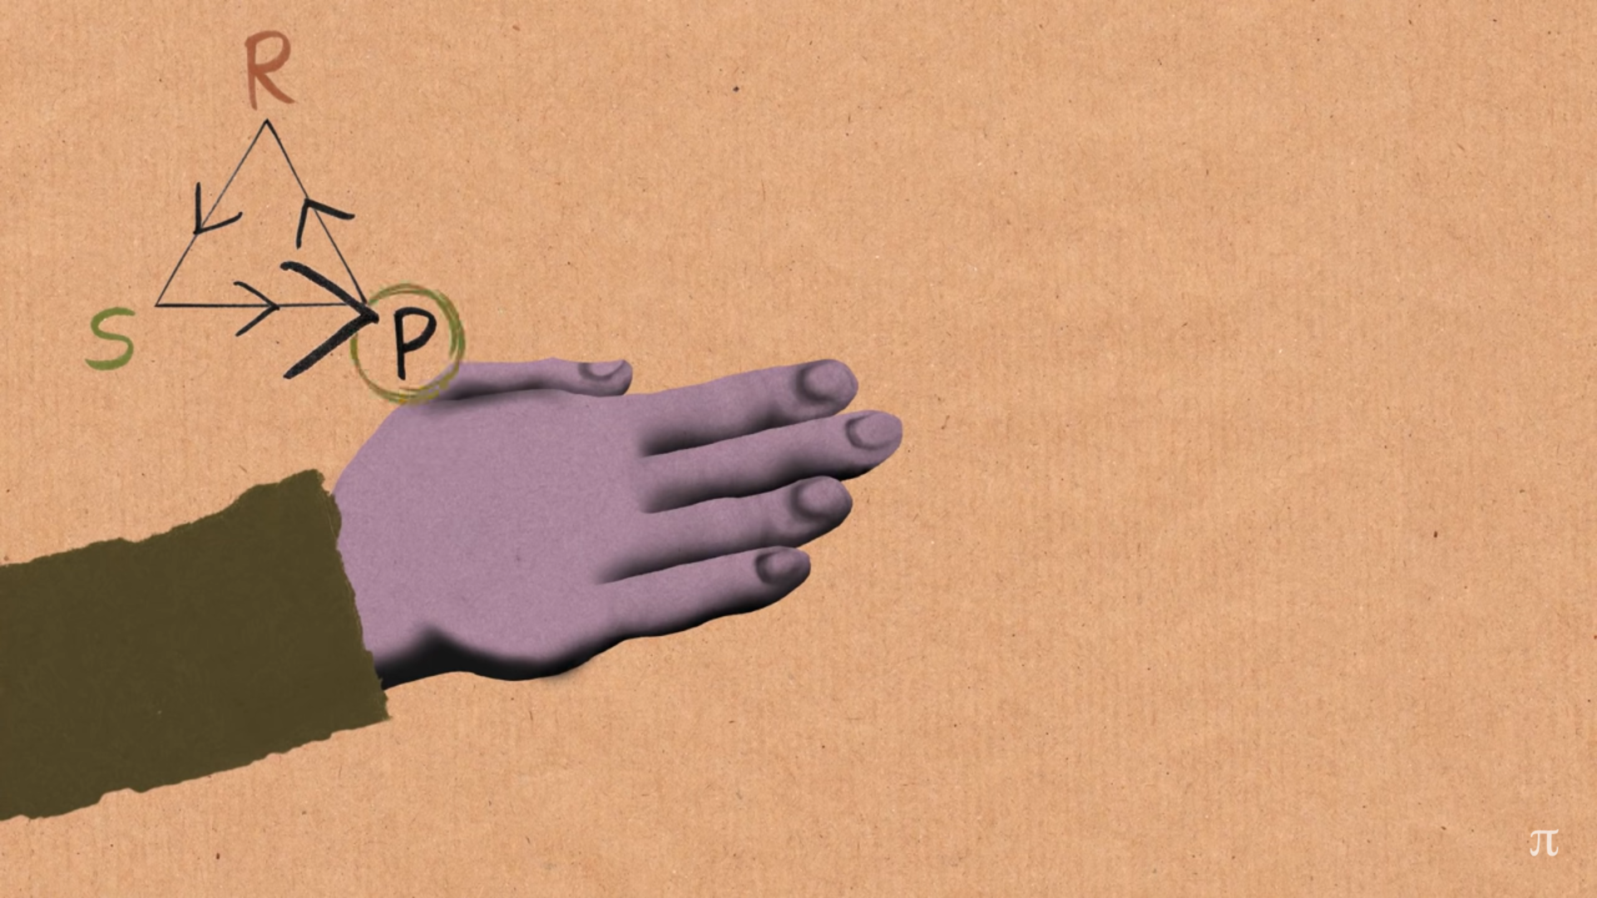

Slide 18
REFERENCES
https://learn.adafruit.com/rock-paper-scissors-circuitpython?view=all
https://www.quantamagazine.org/the-game-theory-math-behind-rock-paper-scissors-20180402/
https://www.researchgate.net/figure/The-Rock-Paper-Scissors-game-A-The-payoff-matrix-Each-matrix-element-is-the-payoff-of_fig1_263200849
https://www.researchgate.net/figure/The-Rock-Paper-Scissors-game-A-Each-matrix-entry-specifies-the-row-actions-payoff_fig1_261761603

Slide 19

Thanks….

